Slide 1
Week 23 - Principal Component Analysis (PCA)

Slide 2
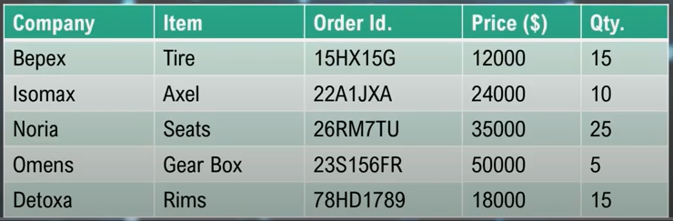
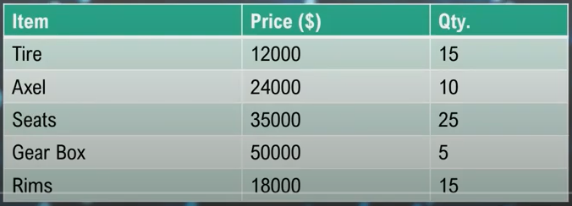
Dimensionality Reduction (降維)
What?
Reducing input variables in a dataset
Why?
Less dimensions = Less computation/training time
Reduce space required for data storage
Simplify for plotting 2D/3D graphs
Discover most significant features
Simplify for human interpretations
Original dataset
3 useful attributes remaining
Correlation Analysis

Slide 3
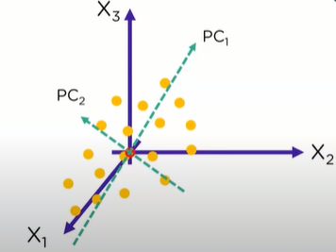
Principal Component Analysis (主成分分析)
Usage
Reduce dimensions, increase interpretations, minimize information loss
Terminologies
Dimensions : columns in dataset
Principal Component : new variables constructed from combinations of initial variables
Projections : perpendicular distance between principal component and datapoints
Properties
Final number principal components <= original number of attributes
Priority of principal component decreased as numbers increase

Slide 4
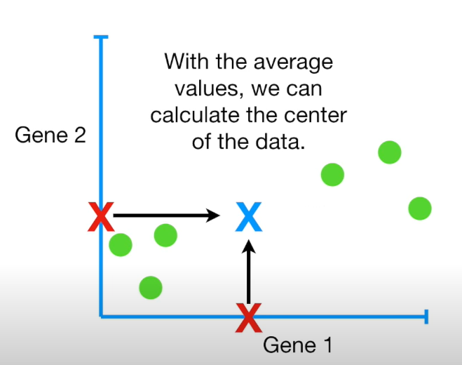
Principal Component Analysis – Theory
After drawing all the data points, calculate the mean on each axis
That’s how we determine the center point (mean value on each attributes/variables)

Slide 5
Principal Component Analysis – Theory
We can now re-center the move all the data point accordingly
That’s how we align the center point (mean value on each attributes/variables)
This way we simplified the process when we calculate of distance

Slide 6
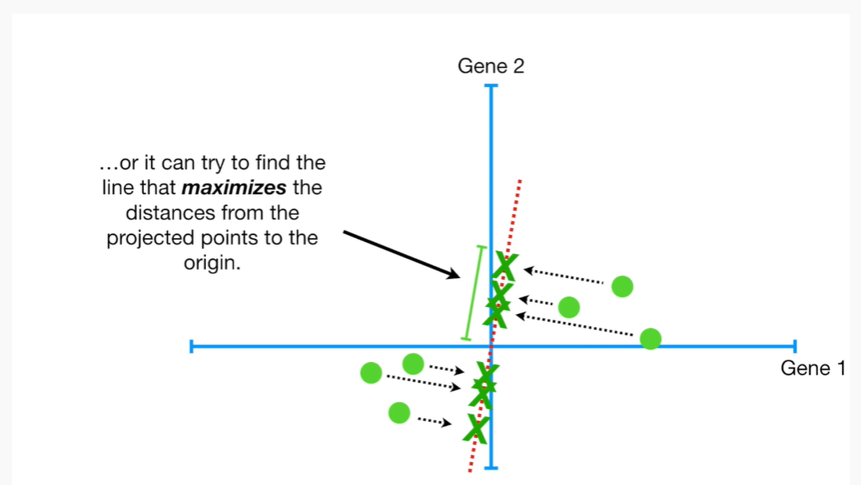
Principal Component Analysis – Theory
Now we can determine the best-fitting line for the new dataset point which cross the center point
New term introduced: sum of square distances = Eigenvalue for PC1

Slide 7
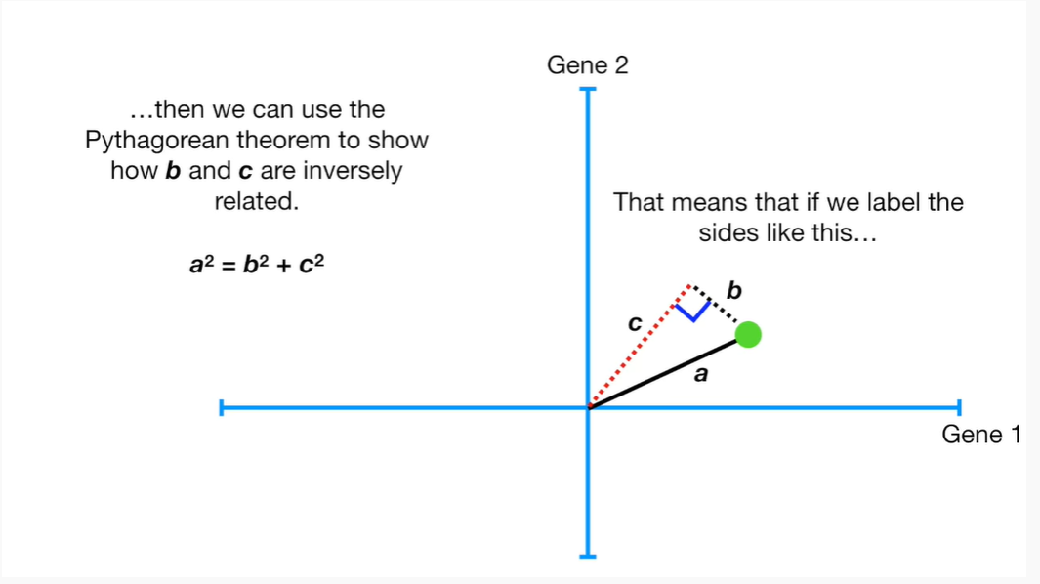
Principal Component Analysis – Theory
We want the best fitting line close to the data points, which means maximizing the projected distance.

Slide 8
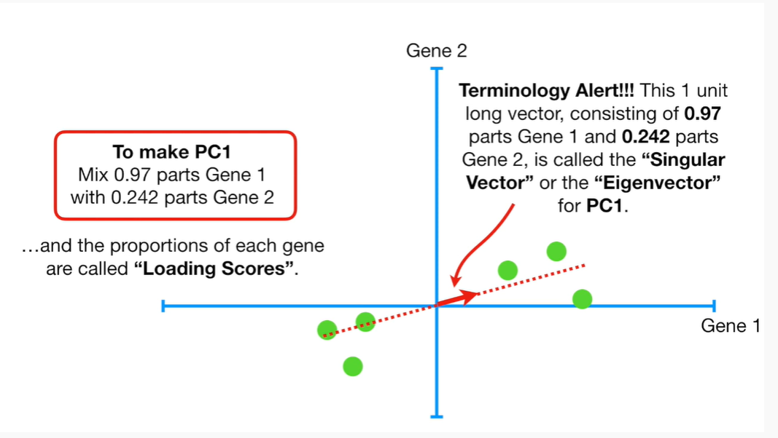
Principal Component Analysis – Theory
Based on the slope of the best-fitting line, we now standardize Eigenvenctor of PC1 in terms of the “proportion” of each variable.

Slide 9
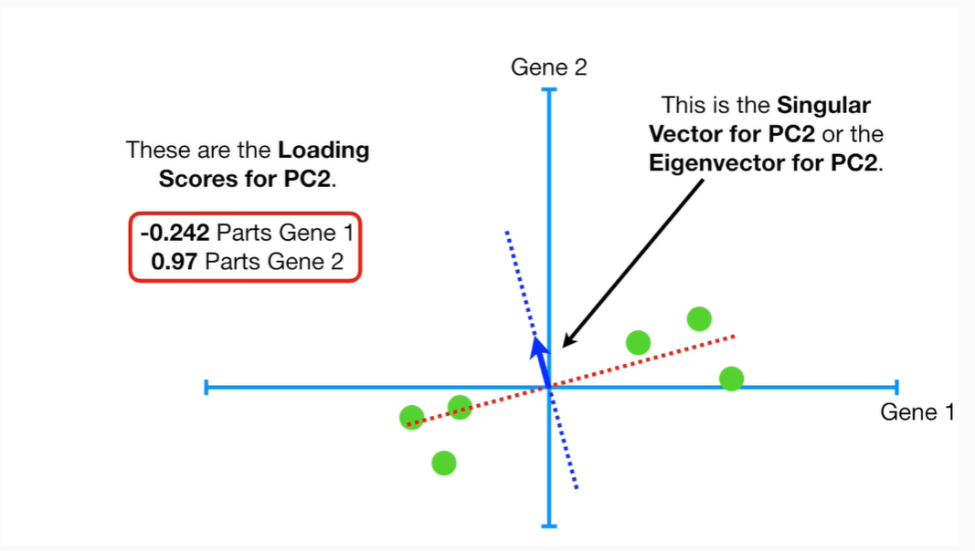
Principal Component Analysis – Theory
Since we ultimately want a 2D graph to interpret the outcome, PC2 would be perpendicular to PC1.
Hence, the slope of PC2 will be automatically determined.

Slide 10
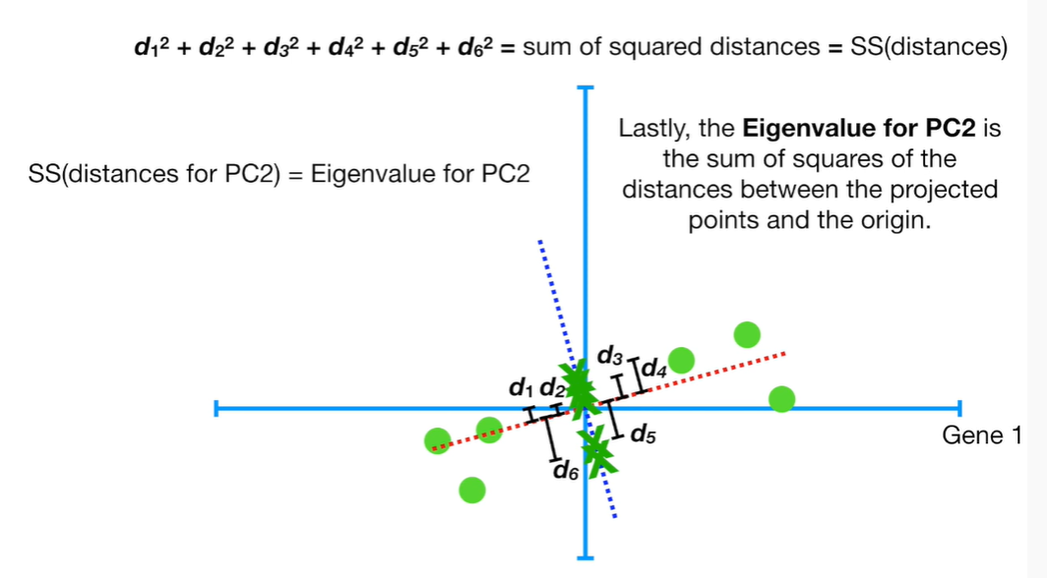
Principal Component Analysis – Theory
Now we have two projections, one on PC1 and the other one on PC2.

Slide 11
Principal Component Analysis – Theory
Rotating PC1 and PC2, and we have a new set of coordinates for this new graph, which is PCA plot

Slide 12
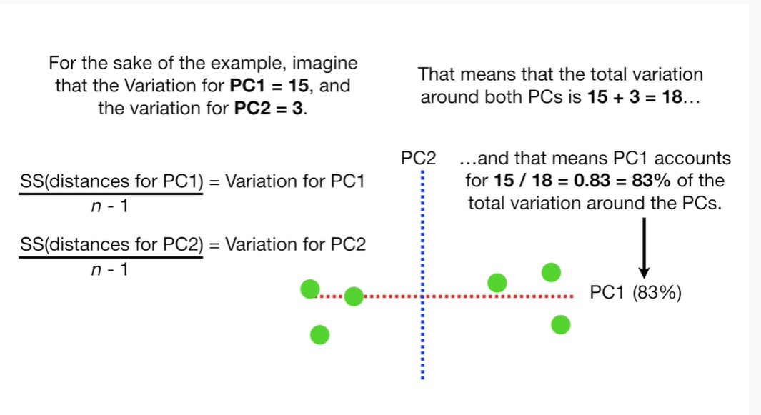
Principal Component Analysis – Theory
Based on calculating the variation for each PCs, we now know how much it accounts for the total variation accordingly.

Slide 13
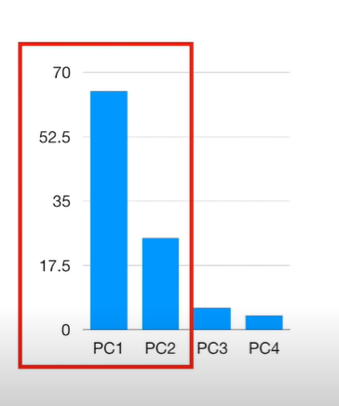
Principal Component Analysis – Theory
A Scree Plot gives you a clear picture of variations around all the PCs.

Slide 14
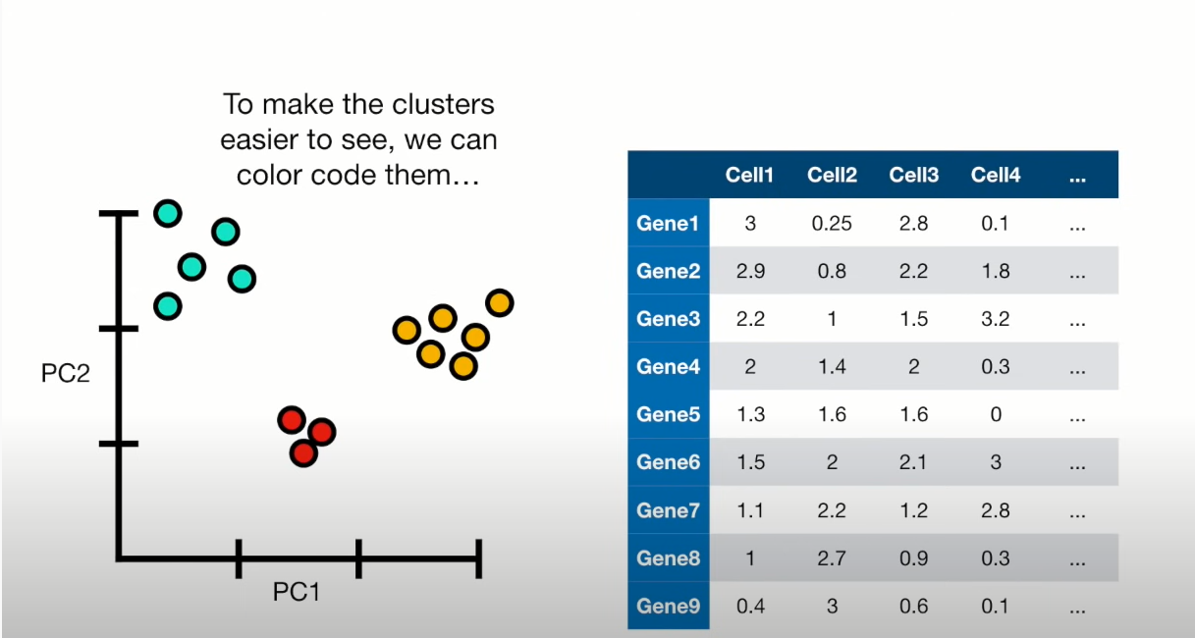
Principal Component Analysis – Theory
Finally, we can determine clusters based on this PCA plot.
Since PC1 accounts for more variance, the horizonal distance account for much more significance than the vertical distance when we differentiate each data point.

